Slide 1

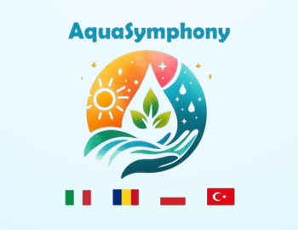



"CLIMATE CHANGE AND ITS EFFECTS" AWARENESS SURVEY REPORT
AquaSymphony: Adaptation to Climate Change and Sustainable Water Use
2023-2-IT02-KA210-SCH-000184958

Slide 2

The objective of the project "AquaSymphony: Adaptation to Climate Change and Sustainable Water Use" is to increase teachers' awareness of the impact of climate change and global warming on water resources and to improve their competence in sustainable water use.
AquaSymphony: Adaptation to Climate Change and Sustainable Water Use
2023-2-IT02-KA210-SCH-000184958

Slide 3

The awareness of educators, who have a great influence and responsibility in contributing to the growth of students, who are the adults of the future, as conscious individuals, and the information they will convey are of great importance. With this sense of responsibility, within the framework of the ERASMUS+ KA2 projects planned under the theme of "Climate Change and its Effects", the opinions of teachers working in different types of institutions and different branches of secondary education (High School) on the subject were collected.
AquaSymphony: Adaptation to Climate Change and Sustainable Water Use
2023-2-IT02-KA210-SCH-000184958

Slide 4
The attitudes of the survey, which was prepared as part of the project, consisted of 14 questions on a five-point Likert scale, and the participating teachers were asked to answer each question as "strongly disagree / disagree / undecided / agree / strongly agree". The opinions of 1788 teachers are included in the headings of the graphs followings.
In line with these opinions, the objectives, activities and outputs of the project were planned according to the needs of the teachers.
AquaSymphony: Adaptation to Climate Change and Sustainable Water Use
2023-2-IT02-KA210-SCH-000184958

Slide 5
If we look at the distribution of the 1788 teachers who participated in the research according to their years of professional experience;
-150 teachers between 1-5 years,
-264 teachers between 6-10 years,
-256 teachers between 11-15 years,
-213 teachers between 16-20 years,
-322 teachers between 21-25 years,
-305 teachers between 26-30 years,
-30 years, we see that there were 277 teachers.
AquaSymphony: Adaptation to Climate Change and Sustainable Water Use
2023-2-IT02-KA210-SCH-000184958

Slide 6
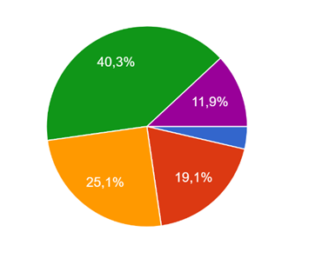
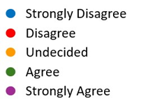

Distribution of awareness levels of teachers participating in the research on international agreements on climate change mitigation and adaptation under the United Nations Framework Convention on Climate Change
According to graph 3, when the distribution of awareness levels of the teachers participating in the research regarding the statement "I am aware of the international agreements on climate change mitigation and adaptation under the United Nations Framework Convention on Climate Change" is examined, it was observed that 65 of them said they strongly disagreed, 341 said they disagreed, 448 said they were undecided, 721 said they agreed and 213 said they strongly agreed.
According to these results, it is observed that almost half of the participants do not have sufficient information about the international agreements on climate change mitigation and adaptation under the United Nations Framework Convention on Climate Change.
AquaSymphony: Adaptation to Climate Change and Sustainable Water Use
2023-2-IT02-KA210-SCH-000184958

Slide 7
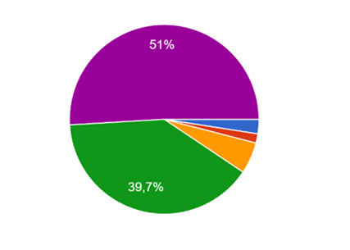
Distribution of awareness levels of teachers participating in the research on the contribution of international coordination on the use of water resources to the fight against global climate change
According to Graph 6, when the distribution of opinions of the teachers who participated in the research is examined regarding the statement "Ensuring international coordination regarding the use of water resources contributes to the fight against global climate change", the participating teachers; It was observed that 44 of them said they strongly disagree, 28 said they disagree, 96 said they are undecided, 709 said they agree, and 911 said they strongly agree.
According to these results; It is seen that 91% of the participants think that international coordination in the fight against global climate change will contribute to the use of water resources.
AquaSymphony: Adaptation to Climate Change and Sustainable Water Use
2023-2-IT02-KA210-SCH-000184958

Slide 8
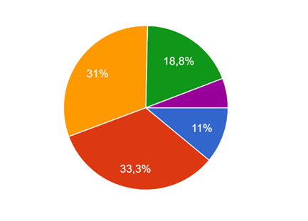
Distribution of the opinions of the teachers participating in the research regarding the issue of the impact of climate change on water resources and adaptation studies being included at an adequate level in the secondary education curriculum for their branch.
According to Graph 7, when the distribution of opinions of the teachers who participated in the research with the statement "The issue of climate change impact on water resources and adaptation studies is adequately included in the secondary education programme for my branch" is examined, the participating teachers; It was observed that 197 of them said they strongly disagreed, 595 said they disagreed, 555 said they were undecided, 337 said they agreed, and 104 said they strongly agreed.
According to these results; It can be seen that almost half of the participants expressed their opinion that the impact of climate change on water resources and adaptation studies are not sufficiently included in the secondary school curriculum.
AquaSymphony: Adaptation to Climate Change and Sustainable Water Use
2023-2-IT02-KA210-SCH-000184958

Slide 9
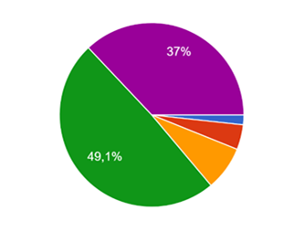
Distribution of opinions of teachers participating in the research regarding the inclusion of water crisis management and adaptation behaviours in the teaching practices of all branch teachers in the context of global climate change.
According to Graph 8, if the distribution of the opinions of the teachers who participated in the research with the statement "Coping with and adapting to the water crisis in the context of global climate change is a subject that all branch teachers can include in their classroom practices" is examined, the participating teachers; it was observed that 31 of them said they strongly disagreed, 78 said they disagreed, 139 said they were undecided, 878 said they agreed, and 662 said they strongly agreed.
According to these results; 86% of the participants expressed the opinion that all branch teachers could include in their teaching practices about combating and adapting to the water crisis.
AquaSymphony: Adaptation to Climate Change and Sustainable Water Use
2023-2-IT02-KA210-SCH-000184958

Slide 10
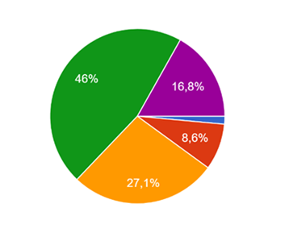
Distribution of awareness levels of teachers participating in the research regarding their ability to meet students' learning needs on adaptation to climate change, drought and efficient use of water resources.
According to Graph 9, when the distribution of awareness levels of the teachers participating in the research with the statement "I am competent to meet the learning needs of students on adaptation to climate change, drought and efficient use of water resources" is examined, the participating teachers; it was observed that 26 of them said they strongly disagreed, 153 said they disagreed, 485 said they were undecided, 823 said they agreed and 301 said they strongly agreed.
According to these results, 63% of the participants think that they are able to meet the learning needs of students on adaptation to climate change, drought and efficient use of water resources. On the other hand, 37% of the participants do not think that they are able to meet the learning needs of students on adaptation to climate change, drought and efficient use of water resources.
AquaSymphony: Adaptation to Climate Change and Sustainable Water Use
2023-2-IT02-KA210-SCH-00018458

Slide 11
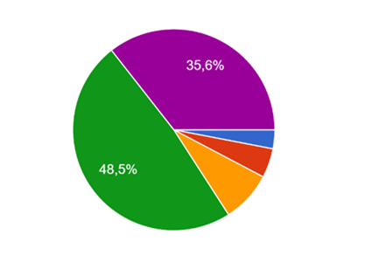
Distribution of opinions of teachers participating in the research on the provision of training for teachers on climate change and its effects, raising awareness at local level and including sustainable solutions.
According to Graph 11, if the distribution of the opinions of the teachers who participated in the research with the statement "There should be training for teachers on climate change and its effects, raising awareness at the local level and including sustainable solution methods" is examined, the participating teachers; it was observed that 54 of them said they strongly disagreed, 84 said they disagreed, 146 said they were undecided, 868 said they agreed, and 636 said they strongly agreed.
According to these results, 84% of the participants agreed with the idea of training teachers at local level on climate change and its effects, raising awareness and providing sustainable solutions.
AquaSymphony: Adaptation to Climate Change and Sustainable Water Use
2023-2-IT02-KA210-SCH-000184958

Slide 12
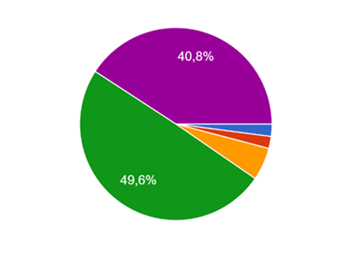
Distribution of opinions of teachers participating in the research regarding the need to increase the number and productivity of educators who can offer solutions to the water problem caused by climate change and who can concretise and implement these suggestions.
According to Figure 12, when the distribution of the opinions of the teachers participating in the research with the statement "It is necessary to increase the number and productivity of educators who can offer solutions to the water problem caused by climate change and who can concretise and implement these suggestions" is examined, it was observed that 37 of them said they strongly disagreed, 36 said they disagreed, 98 said they were undecided, 887 said they agreed, and 730 said they strongly agreed.
According to these results; 90.4% of the participants expressed their opinion on the need to increase the number and productivity of educators who can offer solutions to the water problem caused by climate change and who can concretise and implement these proposals.
AquaSymphony: Adaptation to Climate Change and Sustainable Water Use
2023-2-IT02-KA210-SCH-000184958

Slide 13
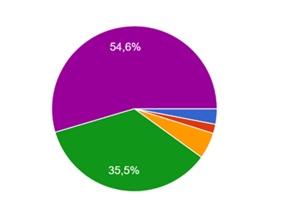
Distribution of awareness levels of teachers participating in the research that since the effects of climate change are not limited to a specific region, efforts to combat this problem should not be limited to the local level, but should be carried out on a transnational scale within the framework of a globally coordinated programme.
According to graph 14, when the distribution of the opinions of the teachers participating in the research on the statement "Since the effects of climate change are not limited to a specific region, efforts to combat this problem should not be limited locally, but should be carried out on a transnational scale within the framework of a globally coordinated programme" is examined, it was observed that 54 of them strongly disagreed, 32 disagreed, 92 were undecided, 634 agreed and 976 strongly agreed.
According to these results; 90% of the participants expressed their opinion that since the effects of climate change are not limited to a specific region, efforts to combat this problem should not be limited to the local level, but should be carried out on a transnational scale within the framework of a globally coordinated programme.
AquaSymphony: Adaptation to Climate Change and Sustainable Water Use
2023-2-IT02-KA210-SCH-000184958

Slide 14
RESULTS AND FINDINGS
The results of the survey on awareness of climate change and its effects show that 90% of respondents have a high level of awareness of the causes and effects of climate change, Almost half of the participants do not have sufficient information about international agreements on climate change mitigation and adaptation under the United Nations Framework Convention on Climate Change.
94% of participants have a high level of awareness of the water problem that will arise as a result of climate change, affecting the sustainability of life,
94% of the participants have a high awareness of the drought that will occur as a result of climate change affecting the sustainability of life in terms of soil fertility and food security.
91% of participants believe that international coordination in the fight against global climate change will contribute to the use of water resources
AquaSymphony: Adaptation to Climate Change and Sustainable Water Use
2023-2-IT02-KA210-SCH-000184958

Slide 15
RESULTS AND FINDINGS
Almost half of the participants agreed that the impact of climate change on water resources and adaptation studies are not sufficiently included in the secondary school curriculum.
86% of the participants expressed their opinion that all teachers in the sector could include the fight against the water crisis and adaptation behaviour in their teaching practices.
37% of the participants feel that they are not able to meet the learning needs of students on adaptation to climate change, drought and efficient use of water resources.
52% of the participants stated that the work being done at the local level to protect water resources in terms of quantity and quality is not sufficient to develop proactive behaviours on this issue, but 29% of the participants were undecided, stating that they do not receive active support.
84% of the participants were in favour of training teachers at local level on climate change and its effects, raising awareness and providing sustainable solutions.
AquaSymphony: Adaptation to Climate Change and Sustainable Water Use
2023-2-IT02-KA210-SCH-000184958

Slide 16
RESULTS AND FINDINGS
90.4% of the participants agreed that there is a need to increase the number and productivity of educators who can propose, concretise and implement solutions to the water problem caused by climate change.
71.2% of the participants stated that they would like to receive training on adaptation to climate change, drought and efficient use of water resources, but 14.8% of the participants were undecided about receiving training.
90% of the participants felt that since the effects of climate change are not confined to a specific region, efforts to combat the problem should not be limited to the local level, but should be carried out on a transnational scale as part of a globally coordinated programme.
It can be seen.
AquaSymphony: Adaptation to Climate Change and Sustainable Water Use
2023-2-IT02-KA210-SCH-000184958

Slide 17
RESULTS AND FINDINGS
According to the analysis results, after assessing the needs of teachers in terms of adaptation to climate change, drought and efficient use of water resources, the main activities and outputs of the project, named AquaSymphony: Adaptation to Climate Change and Sustainable Water Use, were planned as follows
•Teacher training and demonstration of good practice examples,
•Preparation of a handbook with in-class and out-of-class practical activities for teachers by trained teachers,
•The trained teachers should disseminate the joint output by using this handbook in the trainings they will give in their countries,
•Implementation of the manual in schools.
AquaSymphony: Adaptation to Climate Change and Sustainable Water Use
2023-2-IT02-KA210-SCH-000184958

